Slide 1


Animal Predictor
This Project & Presentation is for partial fulfilment of
AI/ML
Submitted By :
CSE-G7(Team 17)
Keshav (2210990502)
Goransh Handa(2210990329)
Khushi Bansal(2210990510)
Khushi Verma(2210990514)
Presented To :
Shubham Sir
Department of Computer Science and Engineering
Chitkara University, Punjab

Slide 2

Table of content
Introduction
3
Meet our Team
5
Technical Details
6
Key Features
7
Project Highlight
8
Future Goals
15
Conclusion
16

Slide 3
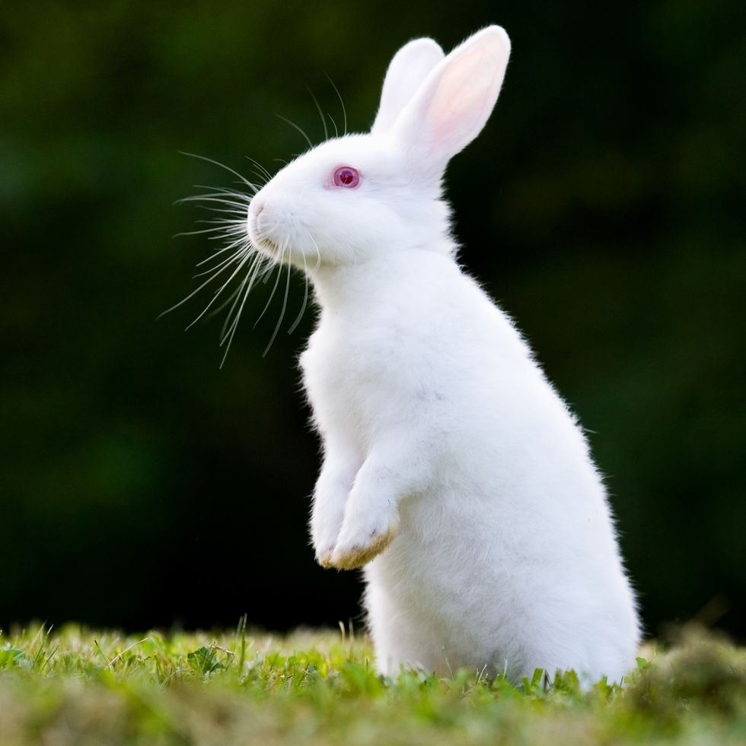
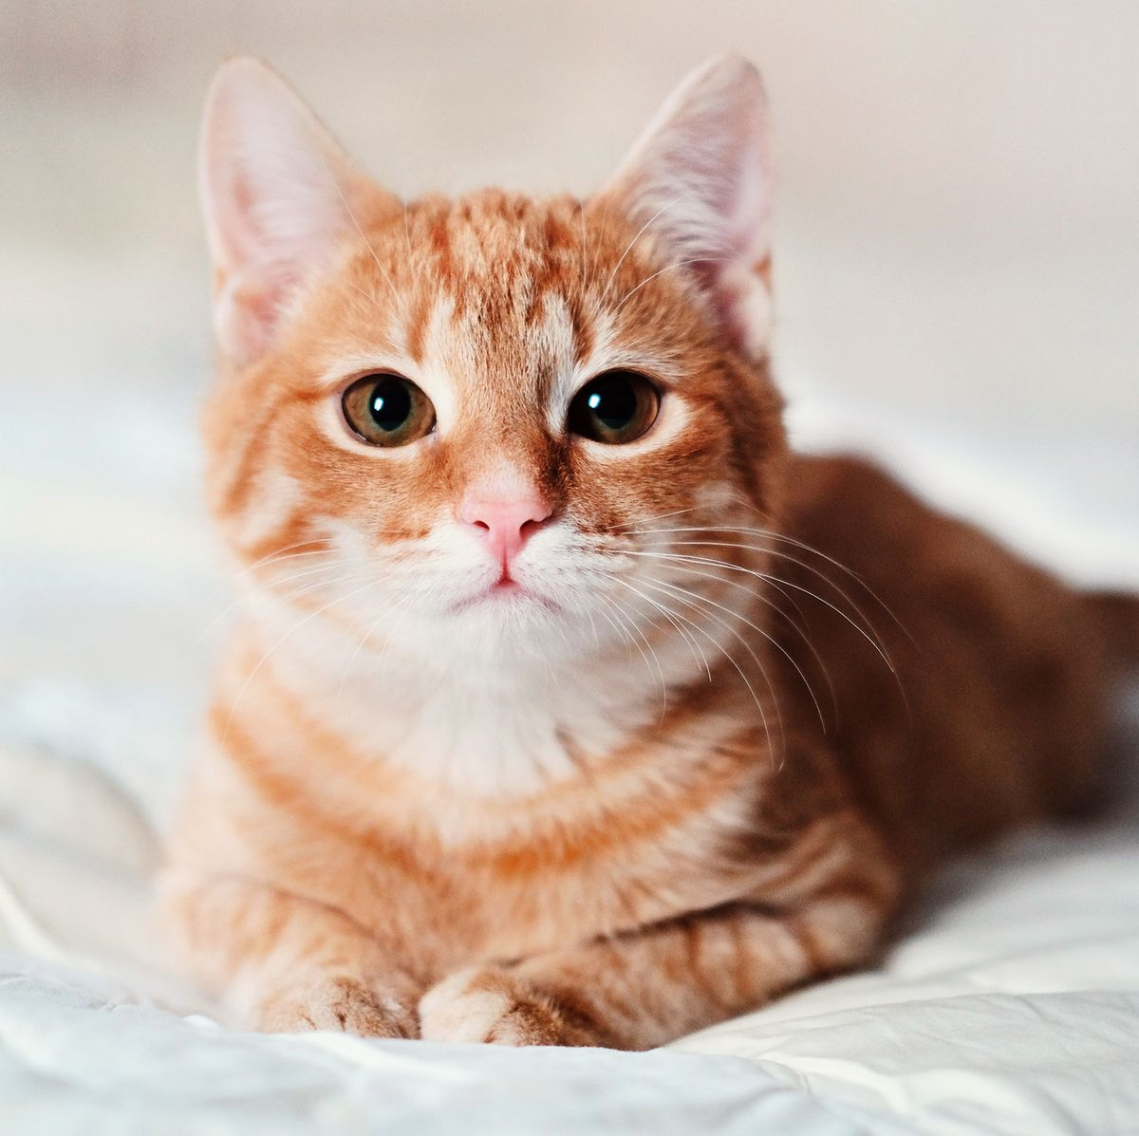

Introduction
"Welcome to Animal Predictor, an innovative project that showcases the power of AIML (Artificial Intelligence Markup Language) in creating an engaging and interactive guessing game. In this project, users will put an image of an animal, our AI system will use AIML patterns to deduce the animal in their mind. Join us on a journey of fun and discovery as we explore the fascinating intersection of AI and human interaction through Animal Predictor."
Ready to experience the next level of Animal Predictor?

Slide 4
Key Features
Certainly! Here are a few key features of the Animal Predictor project made using AIML:
1. Interactive Animal Guessing Game: Engage users in an interactive guessing game where they put iamge of an animal, and the AI system asks a series of questions to deduce the animal.
2. AIML-Powered Conversation: Utilize AIML (Artificial Intelligence Markup Language) patterns to create dynamic and engaging conversations between the AI system and the user, enhancing the user experience.
3. Adaptive Learning:Incorporate adaptive learning techniques to improve the accuracy of guesses over time, making the game more challenging and entertaining for users.
4. Wide Range of Animal Knowledge:Include a comprehensive database of animal information to ensure the AI system can accurately guess a wide variety of animals, from common pets to exotic species.
5. User-Friendly Interface: Design a user-friendly interface that allows seamless interaction between the user and the AI system, enhancing accessibility and ease of use.
6. Educational Value: Offer educational insights about different animals throughout the game, providing users with interesting facts and knowledge about the animal kingdom.
7. Customization Options: Provide customization options for users to tailor their experience, such as difficulty levels, language preferences, or specific categories of animals to guess.
8. Feedback Mechanism: Implement a feedback mechanism for users to provide input on their experience, helping to refine and improve the game over time based on user suggestions.
These features combine to create an entertaining and educational experience for users, highlighting the capabilities of AIML in building engaging AI-driven applications.

Slide 5

V-music
Project Highlights

Slide 6
Certainly! Here are a few highlights for the Animal Predictor project made using AIML:
Intuitive Gameplay:
Users engage in a dynamic and intuitive guessing game, where they think of an animal and interact with the AI system through a series of questions and responses.
2. AI-Powered Guessing:
Utilizing AIML patterns, the AI system intelligently deduces the animal in the user's mind, showcasing the capabilities of artificial intelligence in understanding human input.
3. Educational Entertainment:
The project offers a blend of entertainment and education, providing users with fun gameplay while also imparting knowledge about different animals through interactive conversation.
4. Adaptive Learning:
Through adaptive learning techniques, the AI system continuously improves its guessing accuracy over time, ensuring an increasingly challenging and enjoyable experience for users.
5. Wide Range of Animals:
With a comprehensive database of animal information, the project can accurately guess a diverse range of animals, from common household pets to exotic species from around the world.
6. User-Friendly Interface:
Designed with a user-friendly interface, the project ensures seamless interaction between users and the AI system, enhancing accessibility and engagement.
7. Customization Options:
Users can customize their experience by adjusting difficulty levels, language preferences, or choosing specific categories of animals to guess, tailoring the gameplay to their preferences.

Slide 7
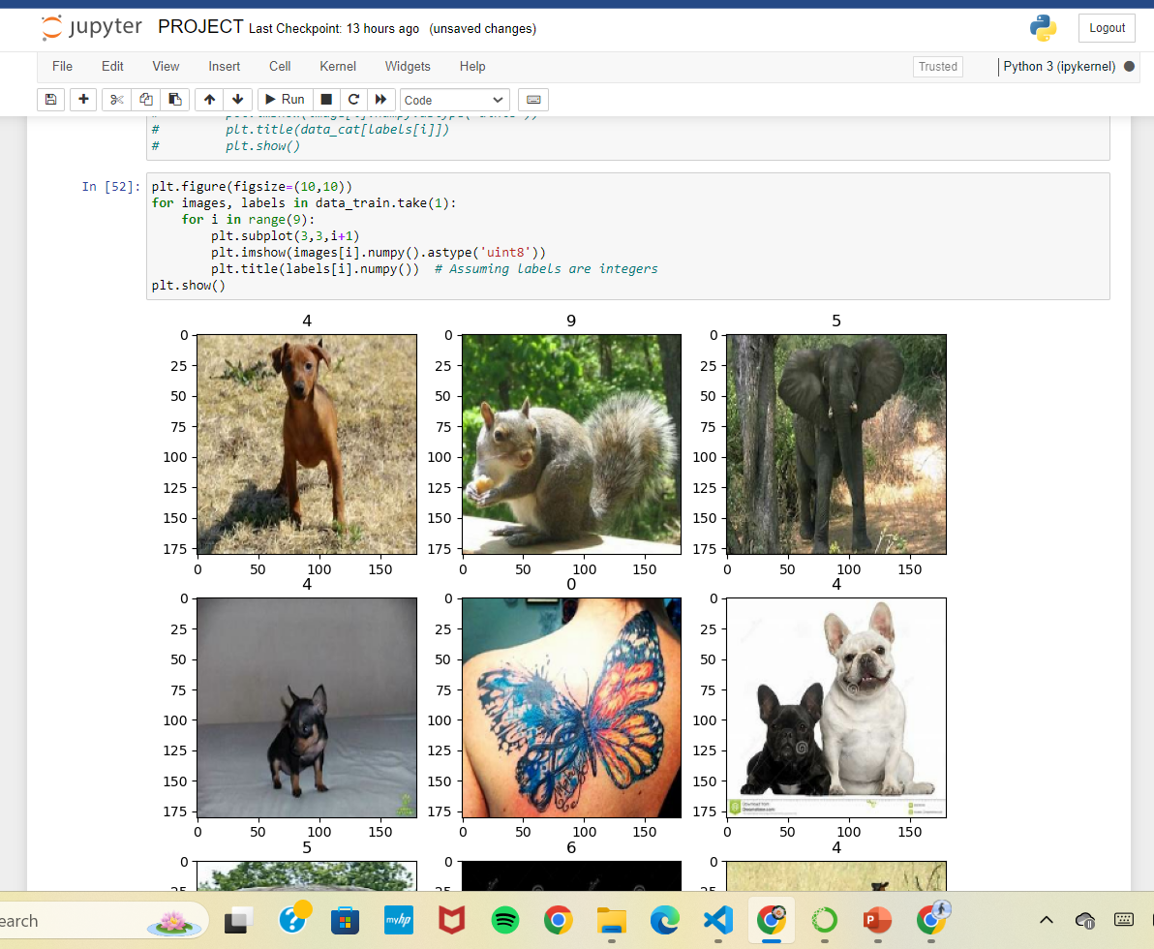
Code Snippets

Slide 8
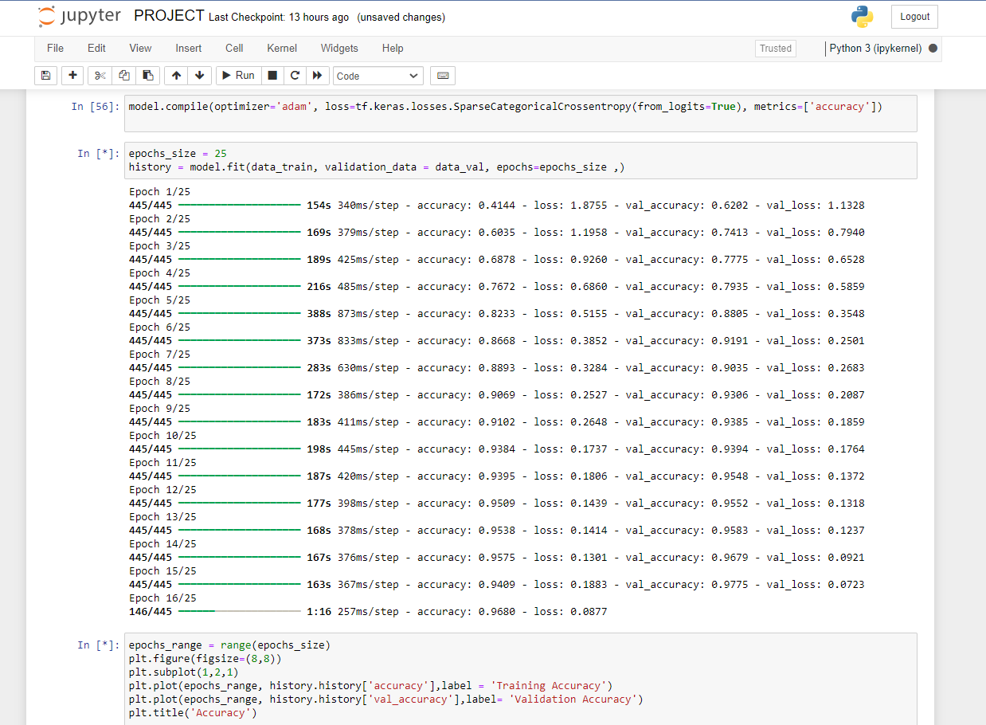

Slide 10
Future Scope
Enhanced AI Capabilities: Continuously improve the AI's guessing accuracy by integrating more advanced machine learning algorithms and natural language processing techniques. This could involve leveraging deep learning models to better understand user responses and refine the guessing process.
Multiplayer Functionality: Introduce multiplayer functionality to allow users to compete against each other in guessing animals. This could involve real-time interaction between multiple users and the AI system, creating a more social and competitive gaming experience.
Mobile Application Development: Expand the project into a mobile application, making it accessible to a wider audience on smartphones and tablets. This could involve optimizing the user interface for mobile devices and integrating additional features such as push notifications and social sharing.

Slide 11
Conclusion
In conclusion, the Animal Predictor project exemplifies the fusion of entertainment and education through AIML technology. With its intuitive interface and adaptive learning, it offers users an engaging guessing game while imparting knowledge about diverse animals. As the project evolves, opportunities for expansion into mobile platforms, integration of augmented reality, and collaboration with educators promise to further enhance its impact, solidifying its place as a captivating and educational AI-driven experience.

Slide 12
Thank You!!

